Slide 1
Introduction
Abylkassymova A.B.

Slide 2

What is Computation?
Now hear we’re in the midst of an “information revolution.” Like the Industrial revolution.
However, this revolution involves not physical labor, but intellectual labor!
Computation isn’t tied to numbers, acronyms, punctuation, or syntax. But one of the things that makes it so interesting is that, in all honesty, it’s not entirely clear what computation really is????

Slide 3
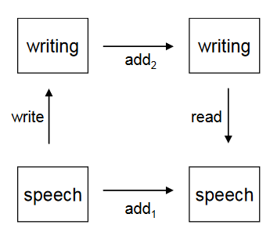
Behavioral equivalence
Example: 7+3=? OR 12374859 + 746592764 = ?
Computation – a kind of question‐answering;
If a Person or System reliably produces the right answer, they can be considered to have solved the problem regardless of what procedure or representation(s) they used.
Behavioral Equivalence is
absolutely central to the modern
notion of computation: if we replace
one computational system with
another that has the “same”
behavior, the computation will
still “work.”

Slide 4
The functional model OR Procedural Model
If we will consider the input value(s) and the desired answer the output value.
Obviously - this is a function!
A function is just a specification of output values for any given input value(s);
A procedure ( an algorithm, program, routine, or subroutine) is a specific method for determining an output value from a set of input values;
Procedures are ways of computing functions and so two procedures are behaviorally equivalent if and only if they compute the same function (although they may different here sources they require such as length of time or amount of scratch paper).
This is a limited view of computation, but it covers a surprising amount of ground.
Remember that the inputs and outputs of our functions don’t have to be numbers. They can perfectly well be things like MP3 files or images from a web cam.

Slide 5
Another aspects
Representation of the information – could affect on our choice of algorithm;
This gives us another model of what computation is, which we’ll call the imperative model: procedures are sequences of commands (imperatives) that manipulate representations;
The process of reading and following a stored representation of a procedure is called interpretation;
Programmable devices are simply devices that can store and interpret representations of procedures;
Computers would be nowhere near the social or economic force they are now if you had to buy separate computers for word processing, email, and editing photos.

Slide 6
Continue
The best example of meta‐programming (ability to write procedures that examine, manipulate, and even create, other procedures) is the use of higher ‐ level programming languages.
The ability of being able to simulate any known computer, is called Turing completeness, Turing equivalence, or just universality;

Slide 7
Okay, so what is computation?
If to type “define computation” into Google?
Computation is a broad, rich field. It has had deep influences on our lives and culture.
If your PC, cell phone, and web access suddenly disappeared, you would probably have to radically reconfigure your life, even though these have only been widely available for the last 15 years.
It’s unlikely that the changes to society are going to stop any time soon. By learning about computation, you can be in a position to help make sure those changes are for the better.

Slide 8
Introduction to Python

Slide 9
Overview
Open source general-purpose language.
Object Oriented, Procedural, Functional
Great interactive environment
Cross-platform (runs on all major operating systems)
Widely Supported (has an active support community with many web sites, mailing lists,..)
Batteries Included (over 300 standard library modules)
Extensible (there are extensive collections of freely available add-on modules, libraries, frameworks, and tool-kits)
Downloads: http://www.python.org Documentation: http://www.python.org/doc/
Free book: http://www.diveintopython.org

Slide 10
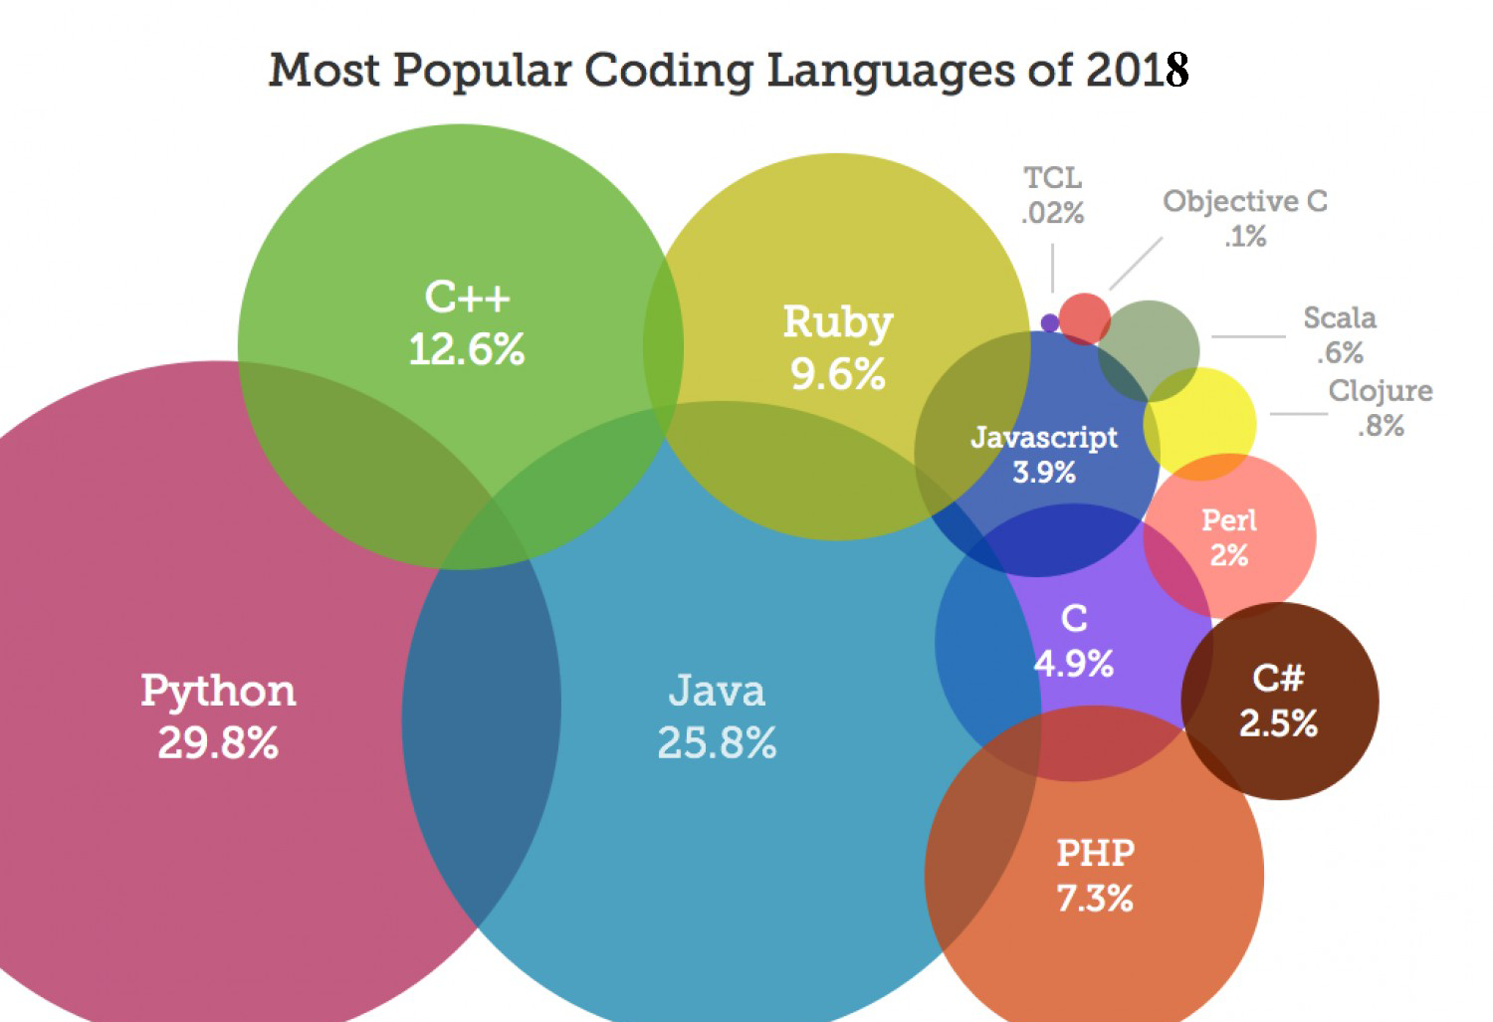

Slide 11
Testimonies
"Python has been an important part of Google since the beginning, and remains so as the system grows and evolves. Today dozens of Google engineers use Python, and we're looking for more people with skills in this language." -- Peter Norvig, director of search quality at Google, Inc.
"Python is fast enough for our site and allows us to produce maintainable features in record times, with a minimum of developers," -- Cuong Do, Software Architect, YouTube.com
….

Slide 12
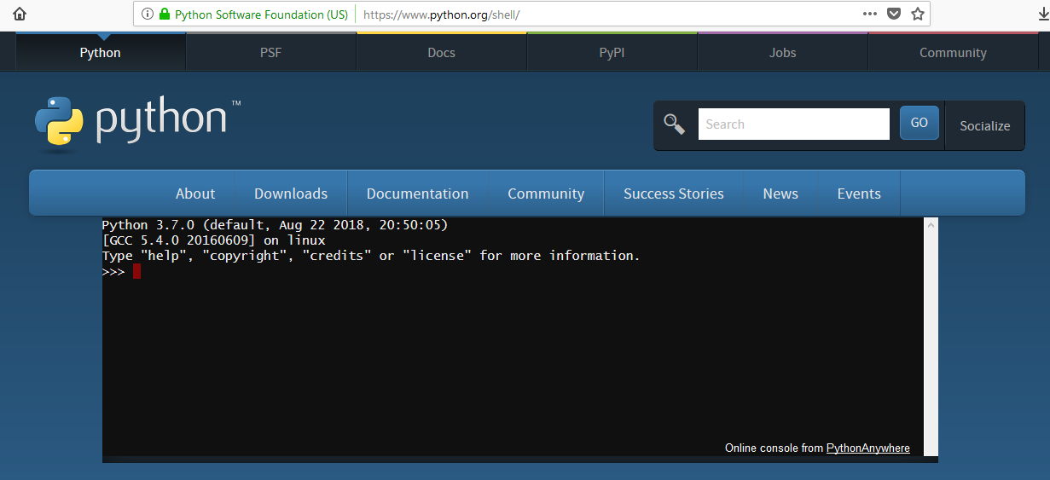
Getting Python
Before downloading – there's a chance that you won't need to download it, since it could already be installed on your computer (feeling happy Linux users?);
Install Python, you should download the most recent stable version, on official web site;
ALTERNATIVE - Online Interpreter (https://www.python.org/shell/)

Slide 13
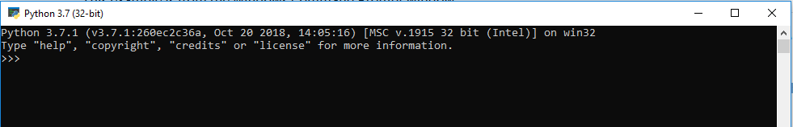
How to start Python?
You can open a terminal window and run the interpreter from the command line;
If you are not seeing the >>> prompt, then you are not talking to the Python interpreter.

Slide 14
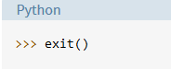

Exiting the Interpreter
Type exit() and press Enter:
In Windows, type Ctrl+Z and press Enter:
In Linux or macOS, type Ctrl+D. The interpreter terminates immediately; pressing Enter is not needed.
If all else fails, you can simply close the interpreter window. This isn’t the best way, but it will get the job done.

Slide 15
IDLE
IDLE is a simple integrated development environment (IDE) that comes with Python.
There are other IDEs for Python (Thonny, Eclipse + PyDev, Sublime Text,…)
I would suggest sticking with IDLE as it is simple to use: code is colored, automatic indentations,…

Slide 16
Hints for using IDLE
The following keystrokes work in IDLE and can really speed up your work:
Keystroke | Result
CRTL+C | Copy selected text
CRTL+X | Cut selected text
CRTL+V | Paste
CRTL+Z | Undo the last keystroke
F5 | Run module
ALT+P | Recall previous command (cycles backward)
ALT+N | Recall next command (cycles forward)

Slide 17
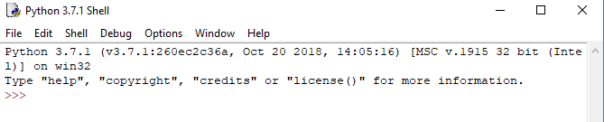

IDLE
You can write a program in the idle and run it like shell
OR
You can save it where you want and then edit it with idle and then
RUN it as usual on C++

Slide 18


The Command Line
Information about python may be obtained by executing python on the Unix command line with appropriate option/s:
Python commands may be executed on the command line with option '-c';

Slide 19
Basic Terminology
Program
Sequence of HLL instructions that specifies how to perform a computation
Follows from your algorithm
Reading in data from keyboard or file or other device (process control)
Output
Display/output data to a screen, file or other device (process control)

Slide 20
Basic Terminology
Recall Python allows you to use Shell or Script mode
Shell
Interactive..
Type in instructions and press return key
Python’s Interpreter attempts to ‘interpret’ your instructions
If successful, it gives you the result
Script
You write all your instructions into a file
You then ‘RUN’ the program
This can be done from command line by telling Python what file to ‘run’ »..or can use IDLE - Python’s default Integrated Development Environment (Graphical User Interface)

Slide 21
Basic Terminology
Testing/Debugging your code (removing errors) is a vital step
Types of Errors
Syntax Errors
Structure of code doesn’t follow the ‘rules’ of the language
Code will not ‘run’ ..Python will give you an error message
Every language has reserved words (keywords)
How many in python?
Runtime Errors
Code will run .. But
Error will appear (at some stage!)
Logical/Semantic Errors
Code runs .. No ‘run-time’ errors.. BUT
Code does not do what it is supposed to do

Slide 22
The Basics
First off, a comment is a number sign, #, (also called a hashtag in social media) followed by some text. A comment is a human readable sentence that Python will ignore. For example, # This is a comment! will not be interpreted by Python.
Second, if you ever see three greater than signs (>>>) and three periods (...), then this implies that the Python shell is being used. Refer back to the previous slides on how to access the shell.
Thirdly, a variable is a namespace , like var and somevar, and it can hold a Python data type, like a number or string that you'll learn about later.
Fourth, like the previous lesson stated, Python 3.7.1 will be used in this course, so make sure you don't use Python 2.X or you'll definitely get an error message.
Fifth, a python script is just a plain text file with python code in it. Refer back to the previous slides for more information.

Slide 23
Basic Syntaxes
Python bears some resemblance to C++, but in general it is cleaner and easier to read.
There are a few important differences from C++ that you should note:
First, you don’t need to declare the types of variables. Thus, you write x = 1 rather than int x = 1.
Second, the environment in which you work with Python lets you type bits of code and see what happens without an intermediate compiling step. This makes experimentation and testing very simple.
Third, a feature of Python that you will grow to love and cherish is how easy it is to read. Instead of using a lot of punctuation and other symbols, which are what makes code in most programming languages look daunting and scary, Python uses English keywords and natural-sounding syntax.

Slide 24
Data Types

Slide 25
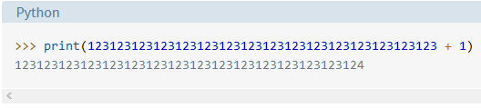
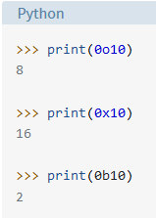
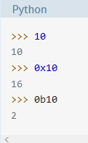
Basic Data Types (Integers)
No limit to the length!
The following strings can be prepended to an integer value:
To display a value while in a REPL session,
you don’t need to use the print() function. Just
typing the value at the >>> prompt and hitting
Enter will display it:

Slide 26
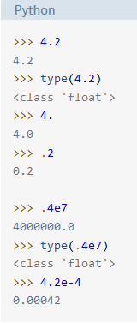
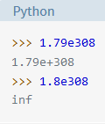
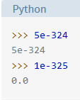
Basic Data Types (Floating-PointNumbers)
Float values are specified with a decimal point;
The maximum value a floating-
point number can have is
approximately 1.8 ⨉ 10³⁰⁸.
Python will indicate a number
greater than that by the string inf;
The closest a nonzero number can
be to zero is approximately
5.0 ⨉ 10⁻³²⁴. Anything closer to zero
than that is effectively zero;

Slide 27
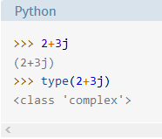
Basic Data Types (Complex Numbers)
Complex numbers are specified as <real part>+<imaginary part>j.
For example:

Slide 28
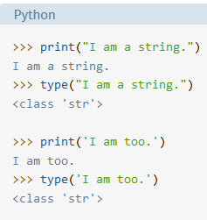

Basic Data Types (String)
Strings are sequences of character data.
The string type in Python is called str.
A string in Python can contain as many characters
as you wish. The only limit is your machine’s
memory resources. A string can also be empty;

Slide 29
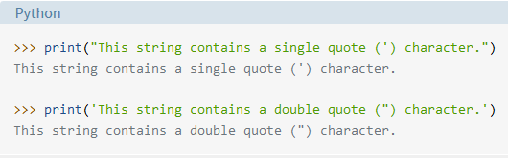

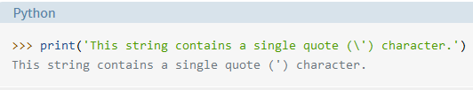

Basic Data Types (String)

Slide 30
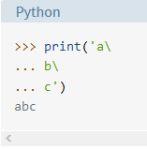
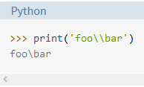
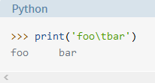

Basic Data Types (String)
The newlines will be ignored:
To include a literal backslash:
A tab character:
The new line:

Slide 31
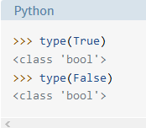

Basic Data Types (Boolean Type, Boolean Context, and “Truthiness”)
You will learn more about evaluation of objects in Boolean context when you encounter logical operators in the upcoming lecture on operators and expressions in Python.

Slide 32
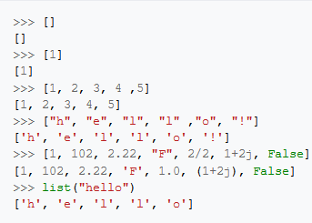
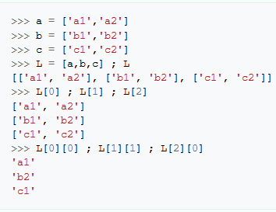
Basic Data Types (Lists)
A set of iterable item(s) A list can contain a two-
dimensional array:

Slide 33
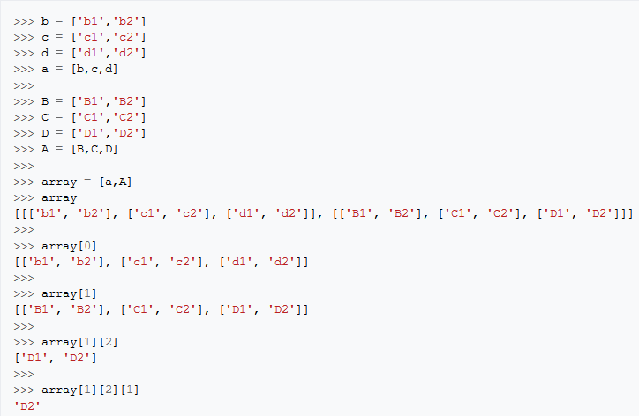
Basic Data Types (Lists)
A list can contain a three-dimensional array:

Slide 34
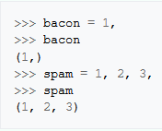
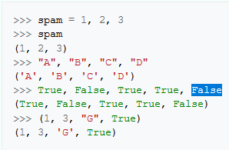
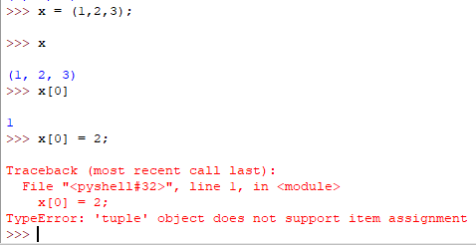
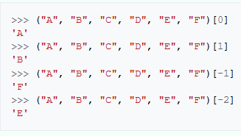
Basic Data Types (Tuples)
Similar to a list, except you cannot dynamically modify the tuple itself;
Tuples are great for holding static data that you don't plan on modifying and changing a lot.

Slide 35
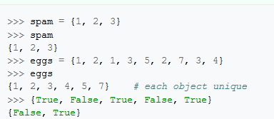
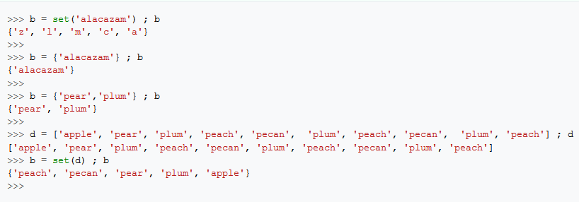
Basic Data Types (Sets)
Sets are mutable
sequences, like lists;
The set can only
contain unique
items;
Initialize the sets:

Slide 36
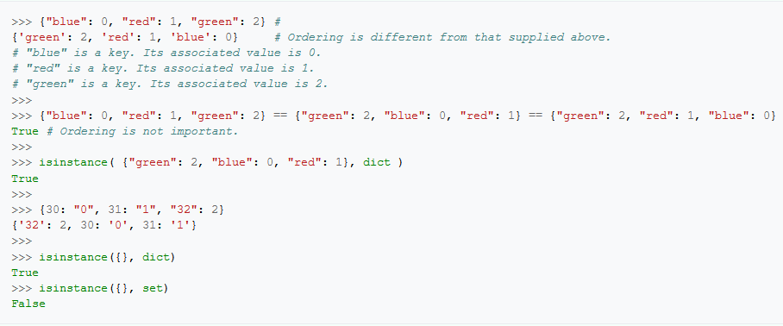
Basic Data Types (Dictionaries)
A random sequences that contain a set of keys, where each key points to a value and is associated with that value;
Sometime is called "associative arrays“;
Dictionaries use the curly braces ({}) like the set, however empty curly braces create a dictionary.

Slide 37
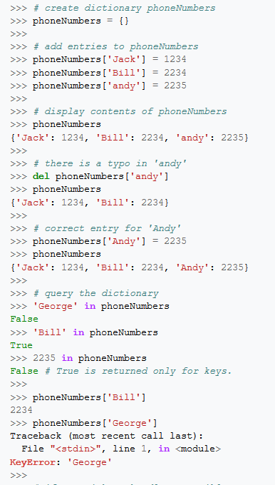
More about Dictionaries

Slide 38
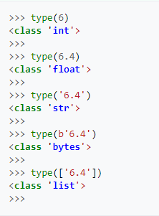
Data Type
Useful Built-in Functions class type(object)
With one argument, return
the type of an object.

Slide 39
Variables

Slide 40
Python Variables
A Python variable is a reserved memory location to store values. In other words, a variable in a python program gives data to the computer for processing.
Every value in Python has a datatype.
Different data types in Python are Numbers, List, Tuple, Strings, Dictionary, etc.
Variables can be declared by any name or even alphabets like a, aa, abc, etc. (Do not advised to do! )

Slide 41

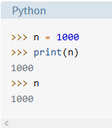
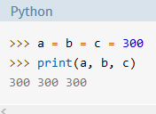
Variable names
Variable names can contain letters, numbers, and the underscore.
Variable names cannot contain spaces.
Variable names cannot start with a number.
Case matters—for instance, temp and Temp are different.
Variables should be declared or defined in advance;
Assignment is done with a single equals sign (=): x = 1

Slide 42
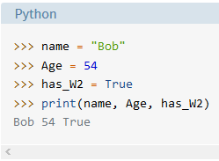
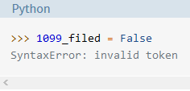
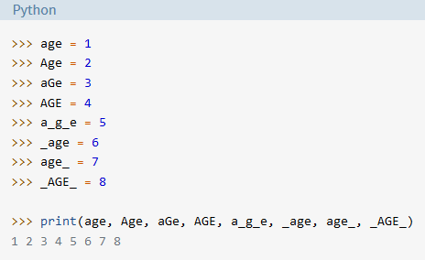
Variable Names Examples
It is worthwhile to give a variable a name that is descriptive enough to make clear what it is being used for.

Slide 43
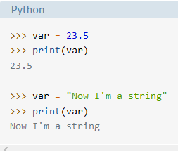
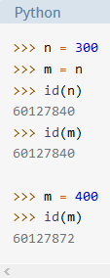
More about Variables
Variables in Python are not subject of restriction. In Python, a variable may be assigned a value of one type and then later re-assigned a value of a different type:
Object Identity - The built-in Python function
id() returns an object’s integer identifier. Using
the id() function, you can verify that two variables
indeed point to the same object:

Slide 44
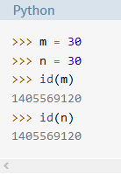
Caching Small Integer Values
For purposes of optimization, the interpreter creates objects for the integers in the range [-5, 256] at startup, and then reuses them during program execution. Thus, when you assign separate variables to an integer value in this range, they will actually reference the same object.

Slide 45
multi-word variable name
The most commonly used methods:
Camel Case: Second and subsequent words are capitalized, to make word boundaries easier to see. (Presumably, it struck someone at some point that the capital letters strewn throughout the variable name vaguely resemble camel humps.)
Example: numberOfCollegeGraduates
Pascal Case: Identical to Camel Case, except the first word is also capitalized. (Recommended for class names)
Example: NumberOfCollegeGraduates
Snake Case: Words are separated by underscores.(Recommended for functions and variable names)
Example: number_of_college_graduates

Slide 46
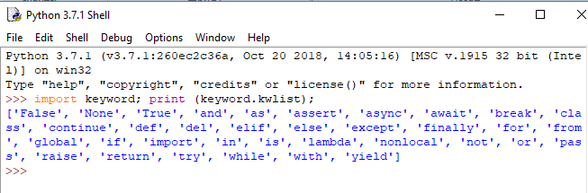
Python Keywords

Slide 47
Operators

Slide 48
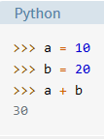
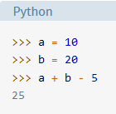
Overview
In Python, operators are special symbols that designate that some sort of computation should be performed.
The values that an operator acts on are called operands.
A sequence of operands and operators, like a + b - 5, is called an expression.

Slide 49
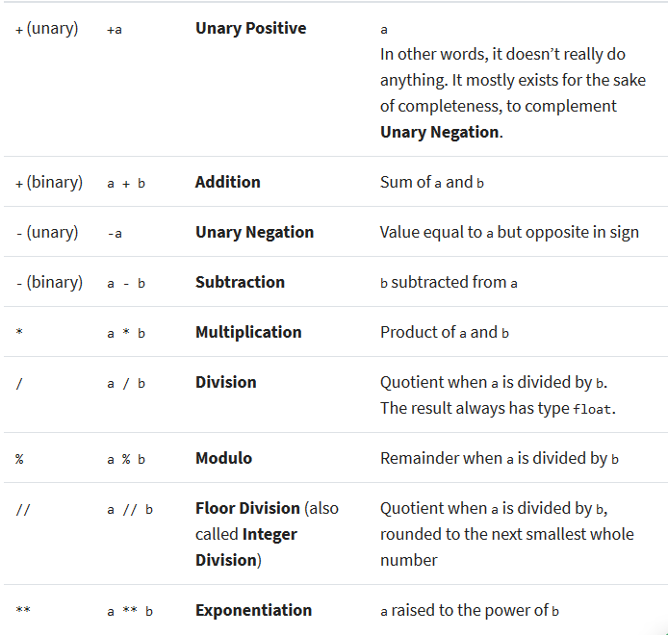
Arithmetic Operators

Slide 50
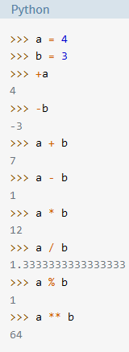
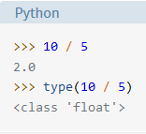
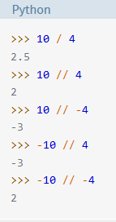
Example of Arithmetic Operators
Why???

Slide 51
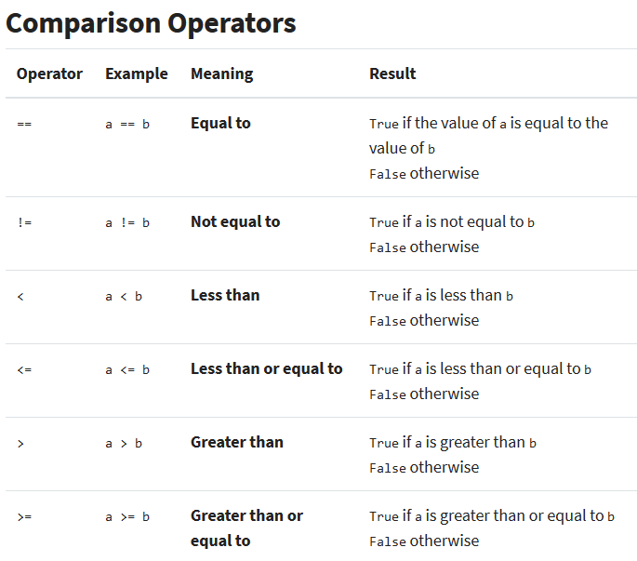

Slide 52
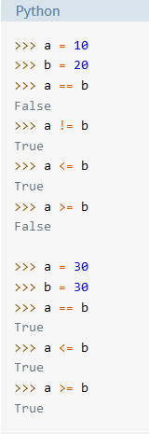
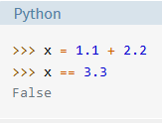

Examples of Comparison Operators
The internal representations
of the addition operands are
not exactly equal to 1.1 and
2.2, so you cannot rely on x
to compare exactly to 3.3.

Slide 53

Logical Operators

Slide 54


Example of Logical Operators

Slide 55

Bitwise Operators

Slide 56


the order of precedence of the Python operators

Slide 57

Equivalent table

Slide 58
Thank You!

